Slide 1



Linguistically Motivated
Neural Machine Translation
Raj Dabre
NICT, Kyoto, Japan IIT Madras, India
IIT Bombay, India
Haiyue Song
NICT, Kyoto, Japan
Hour Kaing
NICT, Kyoto, Japan

Slide 2
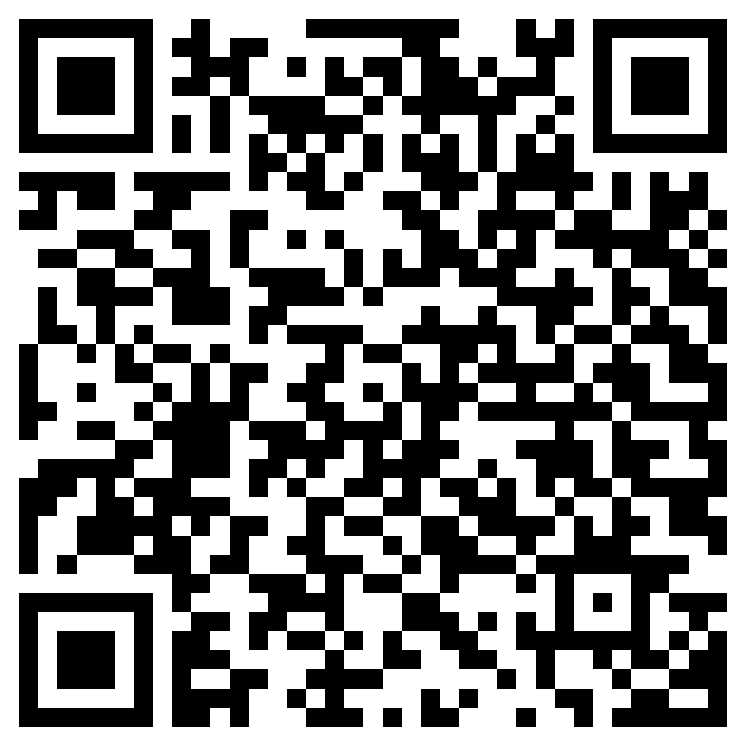
https://github.com/prajdabre/eamt24-linguistic-mt

Slide 3
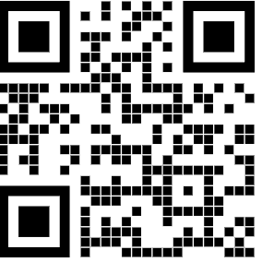


Self Introduction: Haiyue Song
Technical Researcher at National Institute of Information and Communications Technology (NICT)
Research
Low-Resource Machine Translation
Subword Segmentation
Large Language Models for Machine Translation
haiyue.song@nict.go.jp

Slide 4
Self Introduction: Hour Kaing (hour.kaing@nict.go.jp)
Experience
2022 - Present: Researcher at NICT
2018 - 2022 : Technical Researcher at NICT
2018 - 2022 : Ph.D. at Nara Institute of Science and Technology (NAIST), Japan
Low-Resource Morphological and Syntax Analysis
2013 - 2014 : M.Sc at University of Grenoble 1, France
Research interests
Machine Translation, Language Modeling, Linguistic Analysis, and Speech Processing
Low-Resource and Linguistically-Motivated NLP
Cross-Lingual Transfer and Multilingual Learning

Slide 5
Self Introduction: Raj Dabre (raj.dabre@nict.go.jp)
Experience
2018-present: Researcher at NICT, Japan
Adjunct Faculty at IIT Madras
Visiting Researcher at IIT Bombay
2014-2018: MEXT Ph.D. scholar at Kyoto University, Japan
2011-2014: M.Tech. Government RA at IIT Bombay, India
Research
Low-Resource Natural Language Processing
Multilingual Machine Translation: 2012-present
Document Level Machine Translation: 2021-
Large Scale Pre-training for Generation: 2021-
Efficient Deep Learning:
Compact, flexible and fast models (2018-present)

Slide 6
Table of Contents
Introduction to Neural Machine Translation (20 minutes)
Augmenting NMT Architectures with Linguistic Features (60 minutes)
Linguistically Motivated Tokenization and Transfer Learning (30 minutes)
Linguistically Aware Decoding (20 minutes)
Linguistically Motivated Evaluation (20 minutes)
Limitations and Future Directions (10 minutes)
Summary and Conclusion (5 minutes)

Slide 7
Introduction to Neural Machine Translation

Slide 8


Why Machine Translation is still an important task?
Inclusivity and Accessibility
Data Augmentation for Multilingual Performance Enhancement
Bridge gap between low-resource languages (HRL) and high-resource languages (HRL)
Improve language coverage
(only covers ~1K of ~7K in the world)
Transfer Learning via Translation
Unlocking Multilingual Capabilities of LLMs

Slide 9
Evolution of Machine Translation
Rule-Based
Machine Translation
(RBMT)
Example-Based
Machine Translation
(EBMT)
Statistical Machine Translation
(SMT)
Neural Machine Translation (NMT)
Direct MT
Transfer-based MT
Interlingua MT
Word-based
Syntax-based
Phrase-based
RNNs
LSTMs
Transformers
1950 - 1980
1980 - 1990
1990 - 2015
2015 -

Slide 10
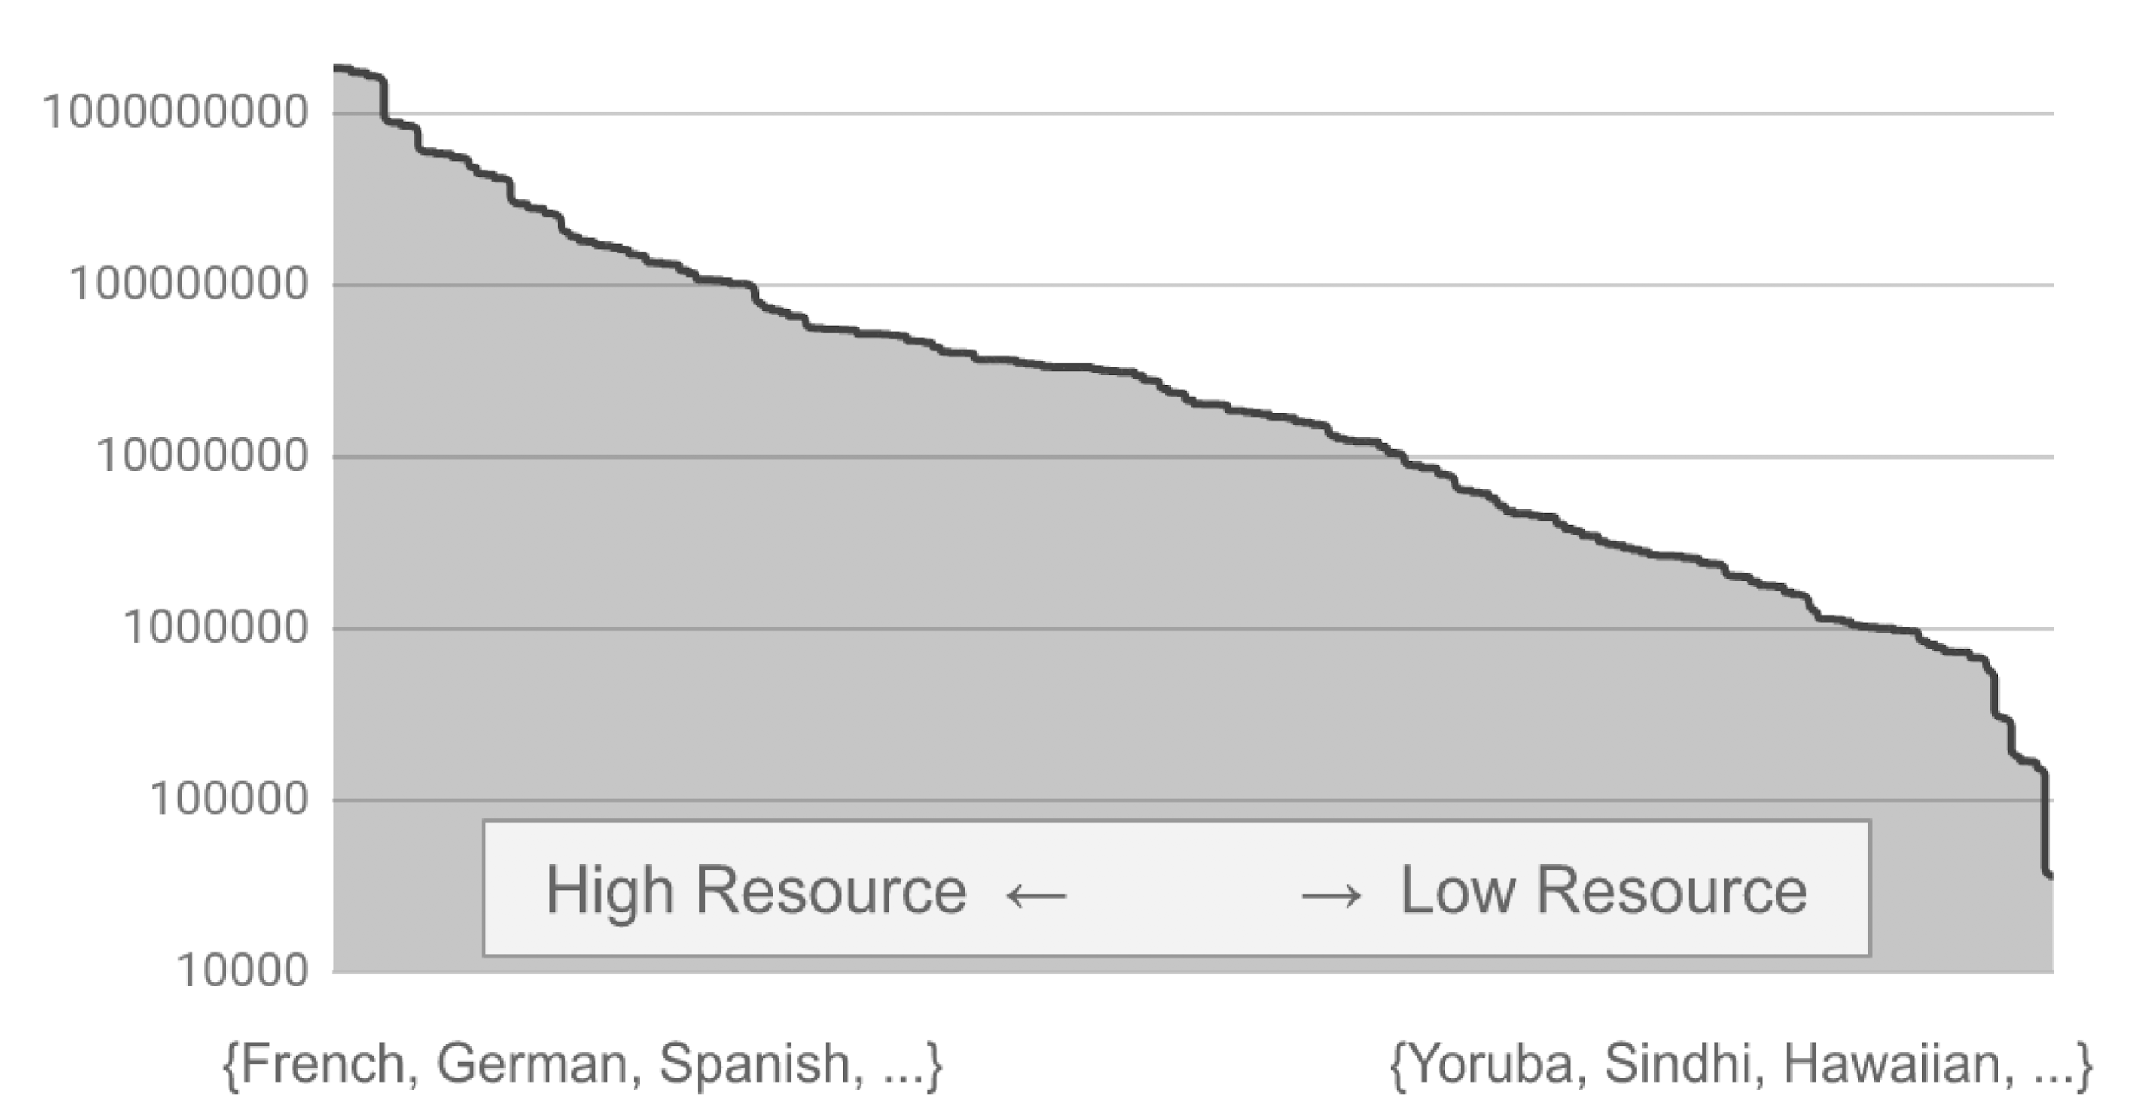
Why NMT? (Good for transfer learning)
Data Distribution over language pairs (Arivazhagan et al., 2019)

Slide 11
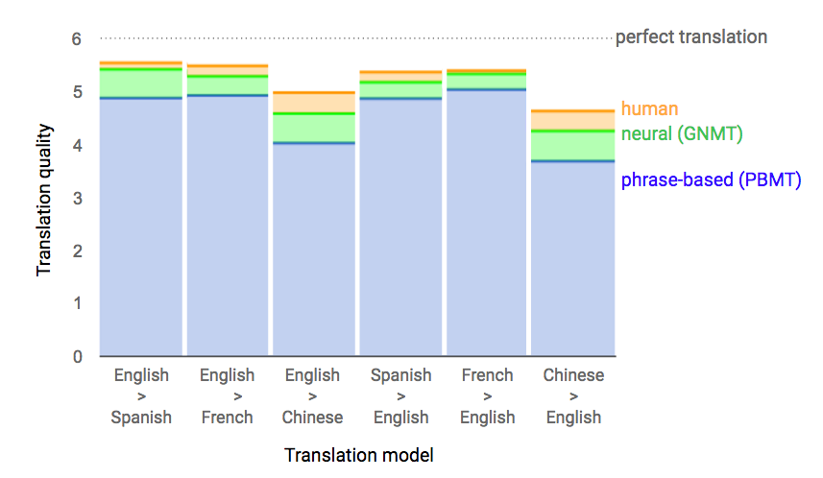
Quality of NMT Compared to Phrase-based SMT
https://research.googleblog.com/2016/09/a-neural-network-for-machine.html

Slide 12
Evolution of Machine Translation
Rule-Based
Machine Translation
(RBMT)
Example-Based
Machine Translation
(EBMT)
Statistical Machine Translation
(SMT)
Neural Machine Translation (NMT)
Direct MT
Transfer-based MT
Interlingua MT
Word-based
Syntax-based
Phrase-based
RNNs
LSTMs
Transformers
1950 - 1980
1980 - 1990
1990 - 2015
2015 -
This Tutorial

Slide 13
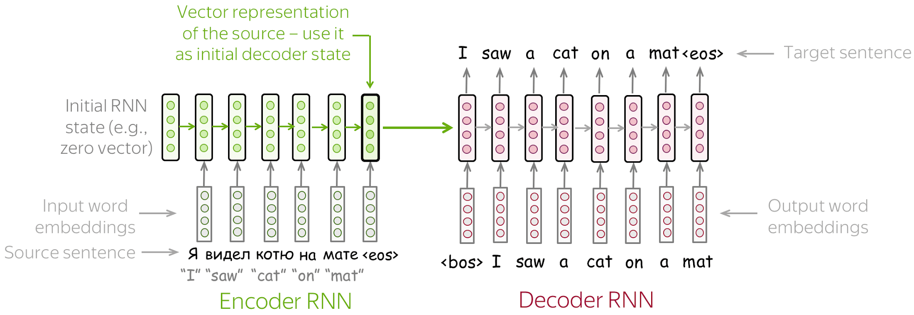
Neural MT Basics: Encoder-Decoder Paradigm
image credits
Sutskever et al. 2014

Slide 14
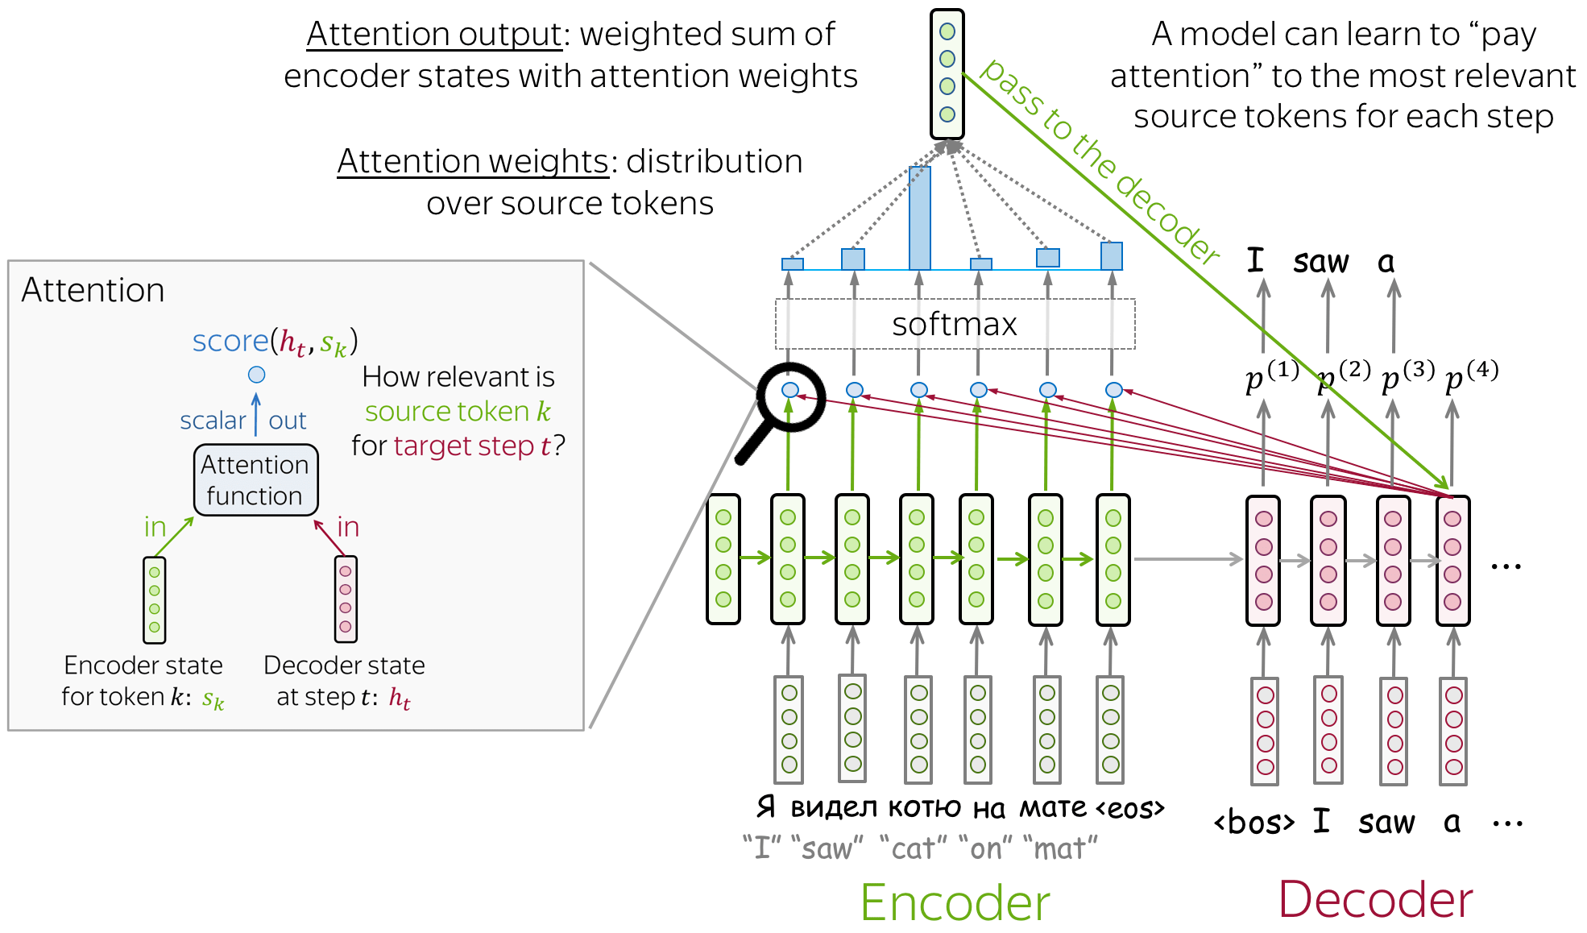
Neural MT Basics: Encoder-Decoder with Attention
image credits
Bahdanau et al. 2015

Slide 15
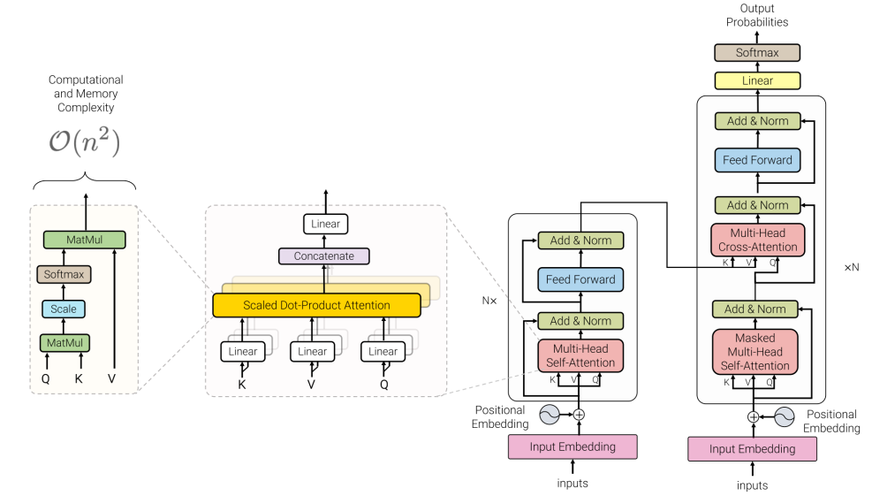
Neural MT Basics: Transformer Architecture
image credits
Vaswani et al. 2017

Slide 16
Is Linguistics dead?
No not quite!

Slide 17
Lets re-think!
Representing linguistic info
as features
Does the model understand words directly?
NO!
What do they understand?
Embeddings
What are embeddings?
Features
Words: I am a boy
POS: PRON VERB DET NOUN
Interchangeable?

Slide 18
Why Linguistic Features?
Supplementary information in low-resource settings
Reduce burden on model to learn complex features
Reuse existing tools rather than waste them

Slide 19
In This Tutorial
What linguistic features can be leveraged?
How do we incorporate them in models?
What is the impact of linguistic features?

Slide 20
Limitations and Future Directions

Slide 21
Limitations
Mostly impactful in low-resource settings :-(
Most languages are low-resource :-)
Identifying useful features needs exhaustive study :-(
In low-resource settings its fine :-)
Interpretability analysis is hard :-(
Extrinsically performance improves :-)
But proving it intrinsically is challenging :-(
Slow speed and error propagation :-(
Requires high quality feature extractors (typically available for English)

Slide 22
Future Directions
Identifying approaches for high-resource settings
Also in multilingual settings
Methods to auto-choose features
Intrinsic analysis of models to show impact of features
Speed improvement
Latent features as opposed to explicit features
Incorporation in LLMs
Mostly open area

Slide 23
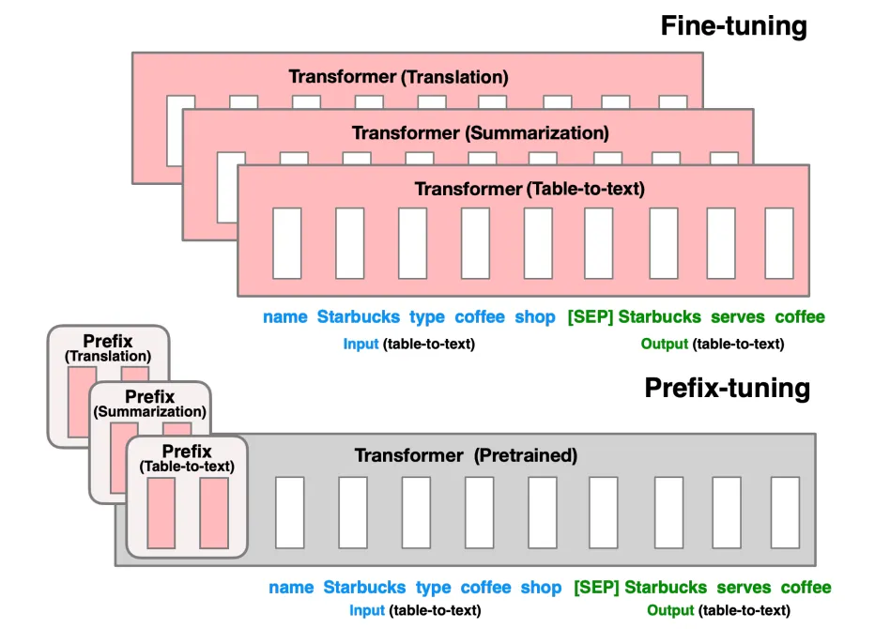
Incorporating in LLMs
Prefix or Prompt Tuning? (Li et al. 2021)
Few shot prompting? (Brown et al. 2020)
As disambiguating information
As additional contextual information

Slide 24
Summary

Slide 25
Summary
Basic overview of NMT and motivation
Methods to incorporate features at various points in the system
Data: tokenization and related languages
Model: inputs, encoder, representation, and self-attention
Decoding: tree-structure decoding
Evaluation: linguistic benchmark
Comparison of effective practices
Limitations and Future Work

Slide 26
Q&A
Thank You

